Slide 1
Oakland County Neighborhood & Housing Development Division
Community Development Block Grant (CDBG)
PY 2026 CDBG Application Workshop
September 25, 2025

Slide 2
Welcome
We’re glad you’re here!
Oakland County Neighborhood & Housing Development
CDBG Team
Khadija Walker-Fobbs, Officer
Curtis Smith, Chief
Peter Essenmacher, Supervisor Contract Compliance
Ashley Hinton, Grant Compliance Coordinator
Katie Tierney, Sr. Specialist - Environmental Officer
Lauren Loiselle, Sr. Public Health Clerk
Simone Craig, Assistant

Slide 3
  Welcome & Introduction
  Khadija Walker-Fobbs , Housing Officer
  Housekeeping & Updates
  Ashley Hinton, Grant Compliance Coordinator
  PY2026 CDBG Application, Program Rules, Eligibility & Application Process
  Ashley Hinton, Grant Compliance Coordinator
  Neighborly Introduction
  Kyle Hines, Housing Trust Fund Manager
  Environmental Review Record
  Kathleen Tierney, Senior Specialist
  Contract Compliance
  Pete Essenmacher, Supervisor Contract Compliance
  Q&A
  Closing & Next Steps
  Ashley Hinton, Grant Compliance Coordinator

Slide 4
Housekeeping
Attendance/CBDG Primary Contact
Attendance is mandatory. Please be sure to sign in and confirm your name, community, and email address is correct.
Monthly Virtual Office Hours
3rd Tuesday of every month
October 21st & November 18th
CDBG 101
In person CDBG Training.
Hosted quarterly - 4 times a year starting 1/1/2026.
Workshop Materials & Application
The Workshop is being recorded.
Today’s materials will be available on the NHD Webpage following.
Please visit CDBG Workshop to view the workshop recording, presentation slide, PY 26 Application, Environmental forms, and maps.
Material for today’s workshop will be made available on/by Friday October 10, 2025.
Applications are DUE by 5pm on Friday December 5, 2025.
No late applications will be accepted!

Slide 5
Housekeeping
Financial Reporting
Monthly
Sent via email
Quarterly Subrecipient Report
Sent via email
Communicate project/spending updates
Spending/Timeliness
Minimum of quarterly draws/reimbursements, monthly recommended
Timeliness Ratio must be below 1.5
Keep project selection to what can be completed in 18 months
Record Retention
Each participating community must maintain all application documents for 4 years.
Funding Updates Program 2025
Annual Action Plan submitted & approved by HUD
Subrecipient Agreements/Approval to Spend Letters for PY2025 (October – December)
3 Year Cooperation Agreements will go out April of 2026 covering PY 2027-2029

Slide 6
PY 2026 CDBG Application
  Application Process
  Planning Allocation
  CDBG Program Rules
  Project Eligibility
  Public Hearing
  Citizen Participation
Ashley Hinton, Grant Compliance & Program Coordinator

Slide 7
Application Process
Attend the PY 2026 CDBG Application Workshop
Determine Local Needs
Schedule required Public Hearing
Advertise Public Hearing Notice(s) as Required
Host Public Hearing
Complete Application Materials
  Application
  Environmental Review Record
  Conflict of Interest Certification & Affidavit of Compliance
Prepare Citizen Participation Materials
  Public Hearing
  Affidavit of Publication
  Meeting Minutes OR Governing Body Resolution
Submit Application

Slide 8
PY 2026 Planning Allocations
Exact CDBG funding levels for PY 2026 are not currently available.
Public Services(PS)
  Plan Public Service funding based on last year’s PS allocation
  Confirm with CDBG Staff
Facilities, Infrastructure & Other Activities
  Use the project total to complete the application & public notice.
As in previous years, projects will be approved prior to the funding amounts being made available by HUD.
  Once exact amounts are available necessary adjustments will be made & communicated
PY2026 Estimated Public Facilities Total: $1,221,625 (available for competitive proposals)​
Estimated CVT PS Allocation: $325,000

Slide 9
CDBG Program Rules
  Participation in the 2026–2030 Oakland County CDBG Program requires an annual application.
    All participating communities will be provided with an allocation of CDBG Funds for Public Service Activities
    Participating communities have the option to apply for funding for Public Facilities & Infrastructure Projects.
    All participating communities will still have access to the Home Improvement Program for their eligible residents.
    All participating communities will still have access to free Housing Counseling for their eligible residents.
    All participating communities will have access to Down Payment Assistance for their eligible residents.

Slide 10
CDBG Program Rules
Under the Hybrid Method:
  Public Services (PS) funding will be allocated to all participating communities based on a population & Low Mod formula.
  Infrastructure, public facilities, and other activities funding will be distributed through a competitive process that’s considers completion of the project within 18 months, positive impact on the community, number of residents served, community needs and administrative capacity.

Slide 11
CDBG Program Rules – Public Facilities, Infrastructure, and Other Activities
60% of the Urban County Allocation is reserved for the 52 participating communities for Competitive Proposal Process ​
​Minium Project Allocation: $3,500
  Project Total funding request should be within reason.
  PY2026 Estimated Public Facilities Total: $1,221,625 (available for competitive proposals)​
  PY2026 Estimated CVT PS Allocation: $325,000
Applications will be reviewed by a scoring committee within Oakland County
Accepted projects will be announced prior to the availability of PY2026 funding. Once final funding allocations are confirmed by HUD, necessary adjustments will be made and communicated.
Funding may not be reallocated to another activity

Slide 12
CDBG Program Rules – Public Facilities, Infrastructure, and Other Activities
Funding for PY2026 Public Facilities, Infrastructure, and Other Activities must be expended within 18 months.
Your application/proposal must include;
  A budget and/or cost estimate for the proposed project.
  Detailed and accurate project description
Please be sure to provide specific details on leveraging outside funding within your submitted application

Slide 13
CDBG Program Rules – Public Services
Formula Allocation for PS Amounts
  Consistent with PY 2025 Amounts
  All communities applying for Public Service Activities will receive a formula-based allocation, with a minimum activity amount of $3,500.
HUD Required15% PS Cap
Funding for PY2026 Public Service Activities must be expended within 18 months from July 1st.

Slide 14
Public Services
Multiple Agency Public Service Contracts
PS contracts of same type not permitted
Public Service Contract Duration
PS contracts maximum 18-month duration
PS contracts start July 1st
Project Service Delivery Costs (PSDC)
Communities may be reimbursed for eligible PSDC
Costs related to delivery of eligible project services
Ineligible Uses
  Maintenance of public facilities
  Items that are not an integral structural fixture

Slide 15
PY 2026 Program Rules
Required Draws
Quarterly. Monthly recommended!
Required Expenditures
All funds per year per activity spent in 2 years from Letter to Spend date in IDIS
After 2 years unobligated funds will be evaluated for possible recapture
Micro-Purchase
Goods or services $10,000 or less are considered a micro-purchase and no procurement is required.

Slide 16
2026 – 2030 Consolidated Plan Priorities
  Housing​
  Minor/Mobile Home Repair ​ ​
  ADA Compliance Upgrades ​
  Public Health and Safety Upgrades​

Slide 17
PY 2026 Eligible Projects
The list of eligible projects and CDBG Matrix Codes are listed in the Guidebook.
CDBG matrix codes are used to indicate (but do not establish) eligibility. An activity must be eligible in accordance with the regulations. (See 24 CFR 570.201-570.207)

Slide 18
Eligible Projects - Public Facilities & Improvements
03A Senior Center
03B Facilities for Persons with Disabilities
03C Homeless Facilities (not operating costs)
03D Youth Centers
03E Neighborhood Facilities
03F Parks, Recreational Facilities
03G Parking Facilities
03H Solid Waste Disposal Improvements
031 Flood Drainage Improvements
03J Water/Sewer Improvements
03K Street Improvements
03L Sidewalks
03M Child Care Centers
03N Tree Planting
030 Fire Stations/Equipment
03P Health Facilities
03Q Facilities for Abused and Neglected Children
03R Asbestos Removal
03S Facilities for AIDS Patients (not operating costs)
03Z Other Public Improvements Not Listed in 03A-03T
06 Interim Assistance
11 Privately Owned Utilities
168 Non-Residential Historic Preservation
23 Tornado Shelters Serving Private Mobile Home Parks

Slide 19
Eligible Projects – Acquisition & Disposition
02 Disposition of Real Property
04 Clearance and Demolition
04A Cleanup of Contaminated Sites
08 Relocation

Slide 20
Eligible Projects – Public Services
03T Homeless/AIDS Patients Programs
05A Senior Services
05B Services for Persons with Disabilities
05C Legal Services
05D Youth Services
05E Transportation Services
05F Substance Abuse Services
05G Services for victims of domestic violence, dating violence, sexual assault, or stalking (Haven)
05H Employment Training
051 Crime Awareness/Prevention
05J Fair Housing Activities (subject to Public Services cap)
OSK Tenant/Landlord Counseling
05L Child Care Services
005M Health Services
5N Services for Abused and Neglected Children
050 Mental Health Services
05P Screening for Lead Poisoning
05Q Subsistence Payments
05R Homebuyer Down payment Assistance - Excluding Housing Counseling under 24 CFR 5.100
05S Rental Housing Subsidies
OST Security Deposits
05U Housing Counseling only, under 24 CFR 5.100
05V Neighborhood Cleanups
05W Food Banks
05X Housing Information and Referral Services
05Y Housing Counseling under 24 CFR 5.100 Supporting Homebuyer Downpayment Assist (05R)
05Z Other Public Services Not Listed i.e. (Housekeeping/Safety & Repair/Yard Services)

Slide 21
Eligible Projects – Housing
09 Loss of Rental Income
12 Construction of Housing
13A Housing Counseling, under 24 CFR 5.100, for Homeownership Assistance (138)
13B Homeownership Assistance - excluding Housing Counseling under 24 CFR 5.100
14A Rehabilitation: Single-Unit Residential
148 Rehabilitation: Multi-Unit Residential
14C Rehabilitation: Public Housing Modernization
14D Rehabilitation: Other Publicly Owned Residential Buildings
14F Rehabilitation: Energy Efficiency Improvements
14G Rehabilitation: Acquisition
14H Rehabilitation: Administration
141 Lead-Based Paint/Lead Hazards Testing/Abatement
14J Housing Services, Excluding Housing Counseling, under 24 CFR 5.100
14K Housing Counseling, under 24 CFR 5.100 Supporting HOME Program Housing Activities
14L Housing Counseling, under 24 CFR 5.100, in Conjunction with CDBG Assisted Housing Rehab
15 Code Enforcement
16A Residential Historic Preservation
19E Operation and Repair of Foreclosed Property ("In-Rem Housing")

Slide 22
Eligible Projects – Economic Development
14E Rehabilitation: Publicly or Privately Owned Commercial/Industrial
17 A Commercial/Industrial: Acquisition/Disposition
178 Commercial/Industrial: Infrastructure Development
17C Commercial/Industrial: Building Acquisition, Construction, Rehabilitation
17D Commercial/Industrial: Other Improvements
18A Economic Development: Direct Financial Assistance to For-Profit Business
188 Economic Development: Technical Assistance
18C Economic Development: Microenterprise Assistance

Slide 23
Application Instructions
Applications MUST be completed and submitted as outlined.
(NO EXCEPTIONS)
  Applications must be completed electronically.
    Using Neighborly
  Please provide detailed responses.
  Copy of current SAMS
  Project Budget / Cost Estimate
  Project Description
  Applicable Environmental Review Requirement forms and documentation.
  Notice of Public Hearing (Option 1 or 2)
  Public Hearing Minutes (Option 1 or 2)
  Conflict of Interest Form
  Affidavit of Compliance
  Applications must be fully complete to be considered.
  All applications must be received by Friday, December 5, 2025 at 5:00 p.m.

Slide 24
Application Overview
Application includes:
Program Overview
Applicant Contact Information
Proposed Project
Project Type
Project Details
Project Location
Project Purpose
Required Document Uploads
Submission

Slide 25
PY 2026 Application
PY 2026 CDBG Application
  Available on/by Friday, October 10, 2025
PY 2026 CDBG Application Highlights
  Neighborly Submissions
  No email/pdf process

Slide 26
Neighborly Introduction
Kyle Hines, Housing Trust Fund Manager

Slide 27

Neighborly
In PY26, Oakland County will receive applications through Neighborly
Neighborly is an all-in-on web-based application that provides project, financial and compliance management for recipients of federal funding
Every community will have their own portal to apply for and manage each of your activities
  Each community can have multiple users to complete applications, review spending activities, and submit payment requests
  You will have instant access to see your current spending activity and funding balance
Neighborly is widely used throughout Michigan and the United States including Macomb County and Genesee County

Slide 28
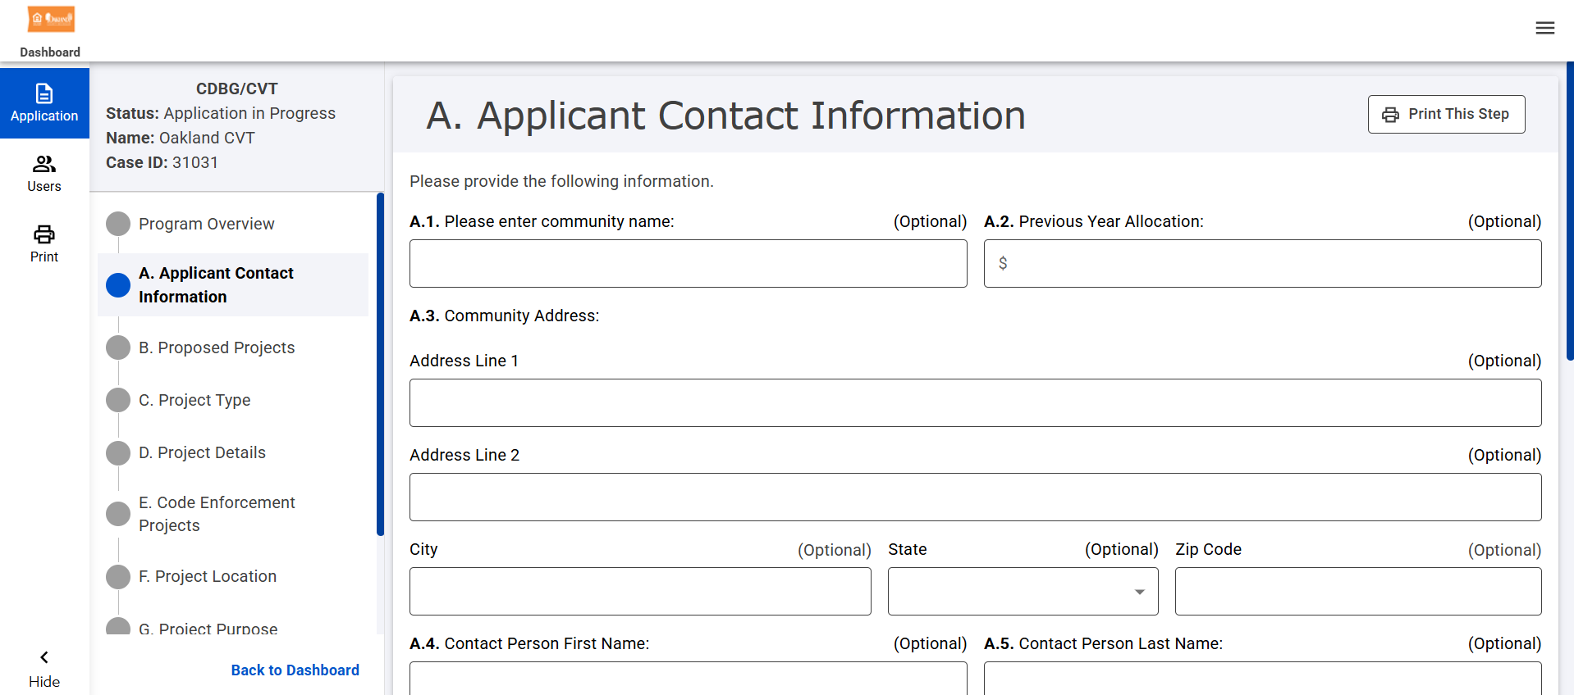
Neighborly
Once everyone has created an account, we will provide a training to walk you through the application process.
The application will mirror the current format; however, all documentation and financial information will be held in each of your specific activities.

Slide 29
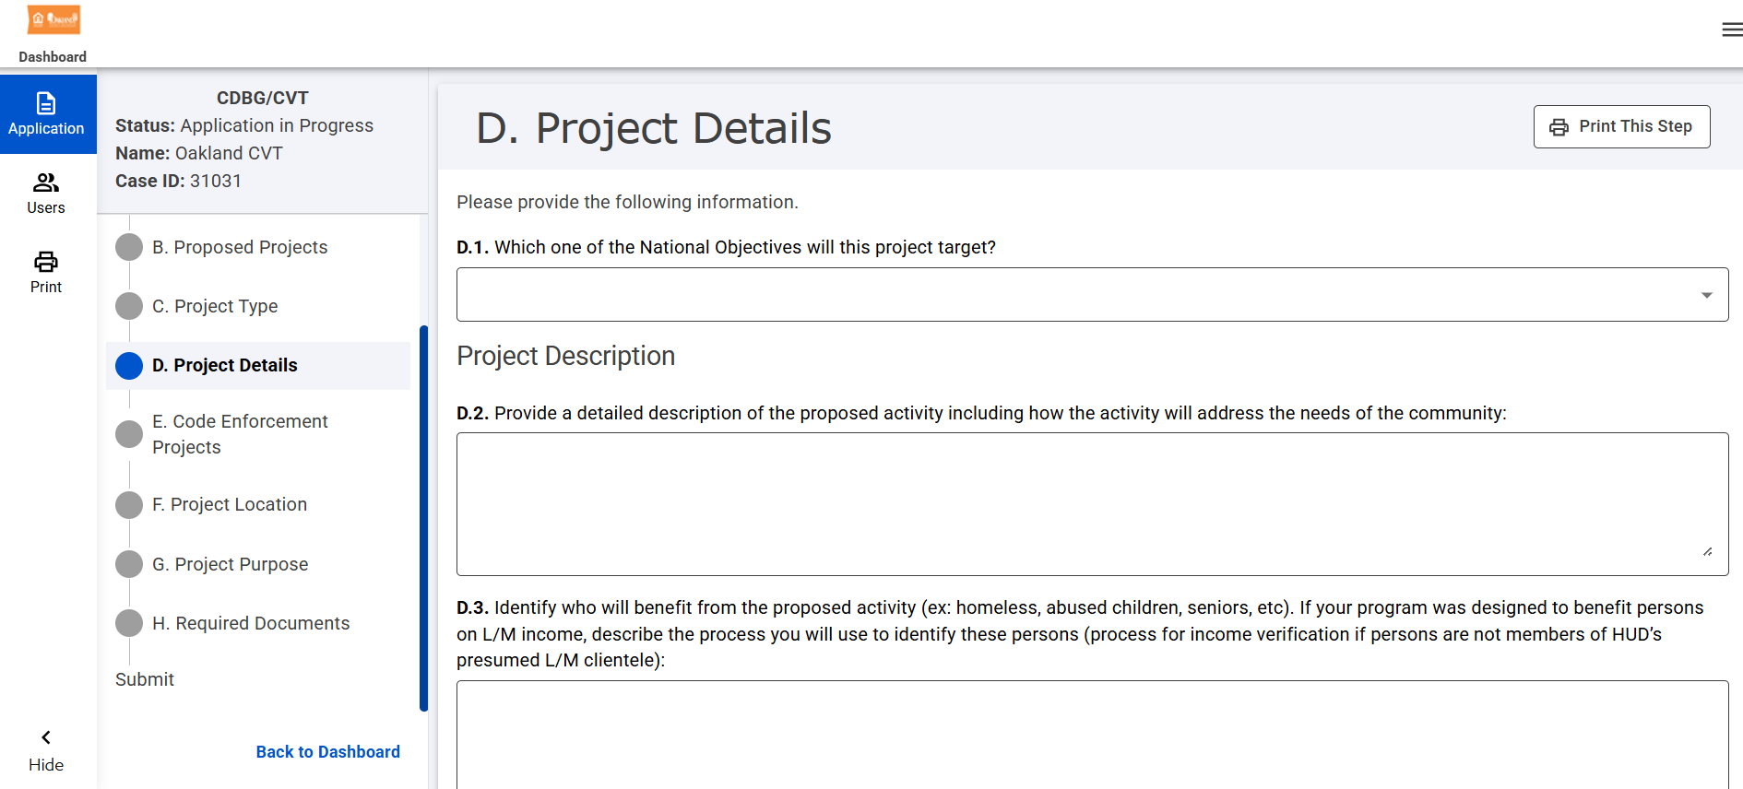
Neighborly

Slide 30
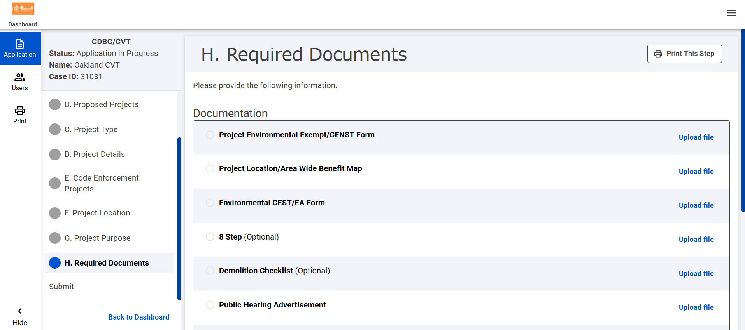
Neighborly

Slide 31
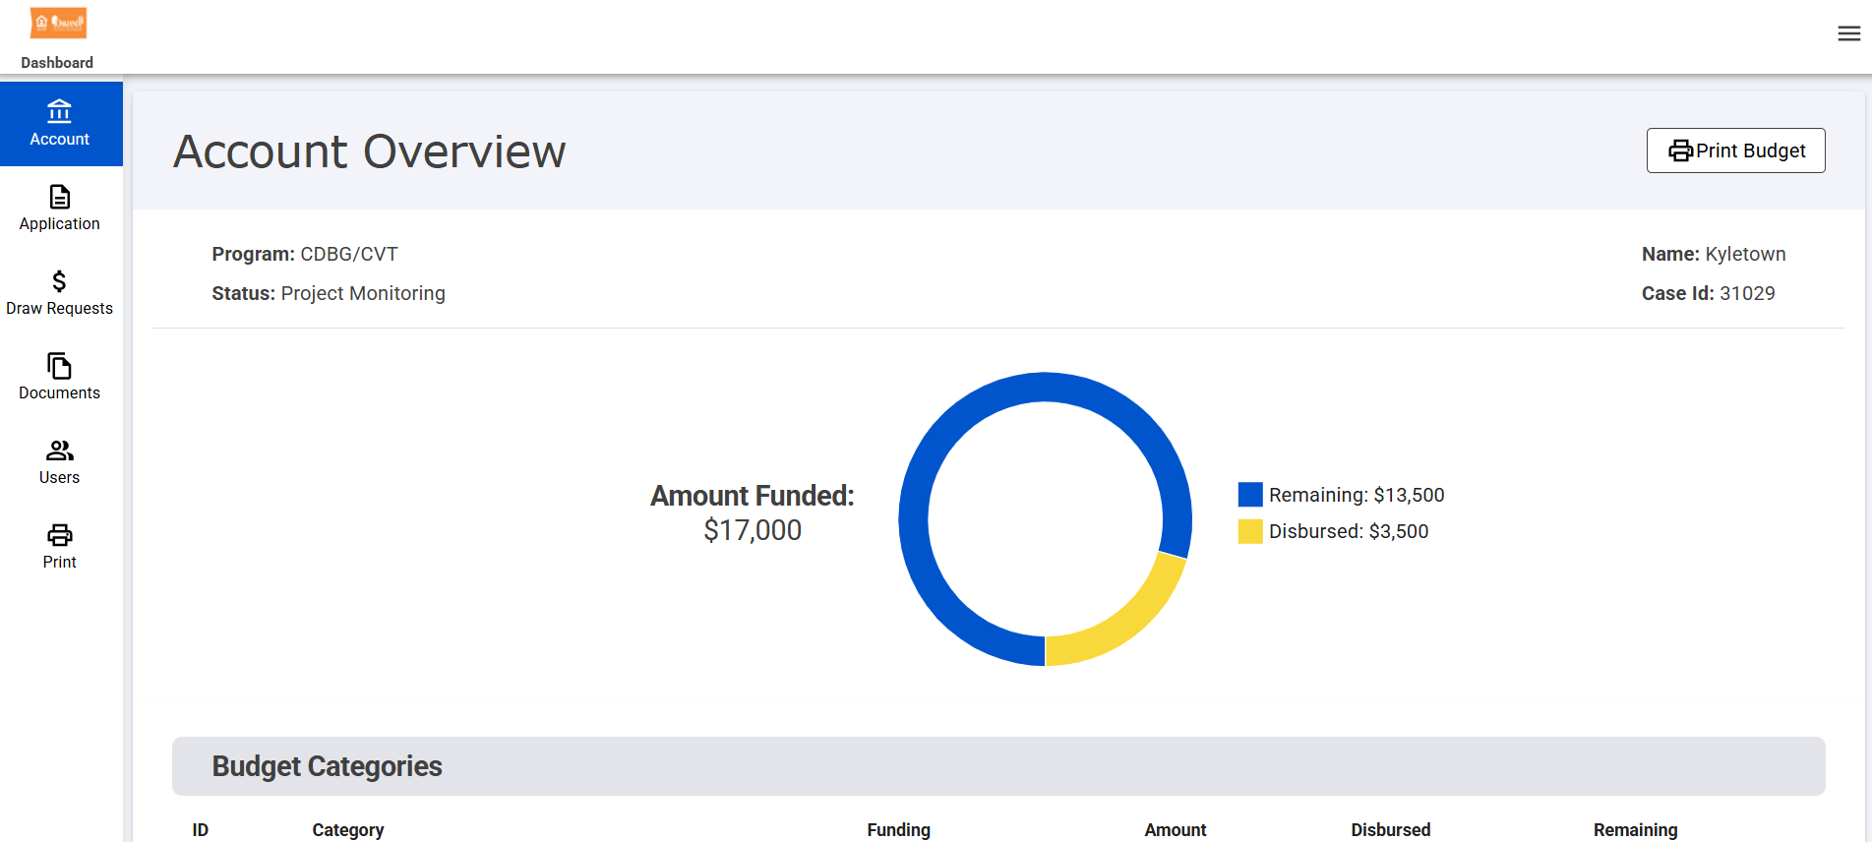
Neighborly
Once your project is approved and funded, you will be able to see your current expenditures and remaining balance:

Slide 32
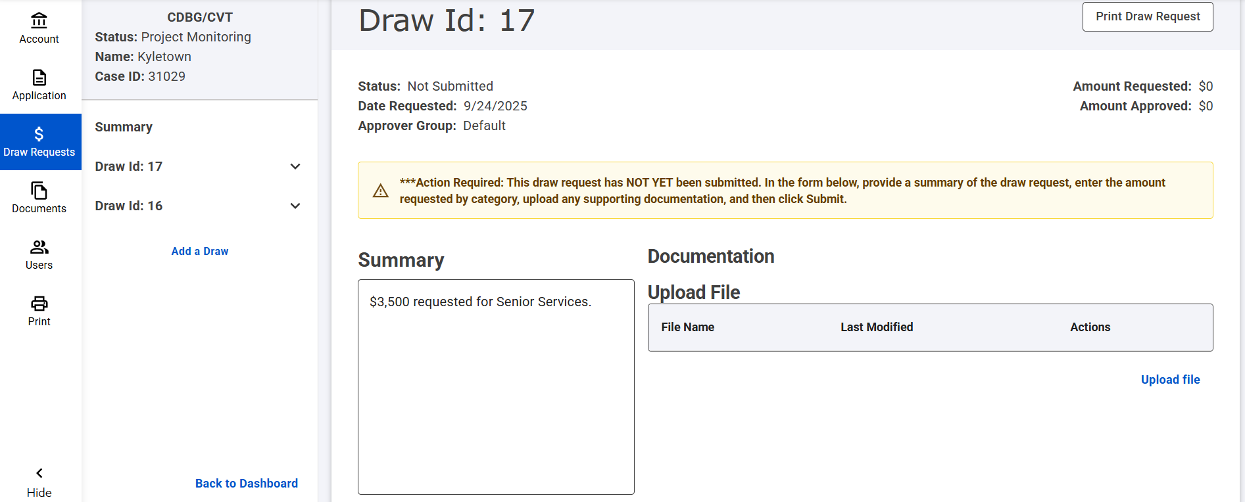
Neighborly
Draw requests and supporting documentation will be submitted through the project portal. Our required draw request information will not change.

Slide 33
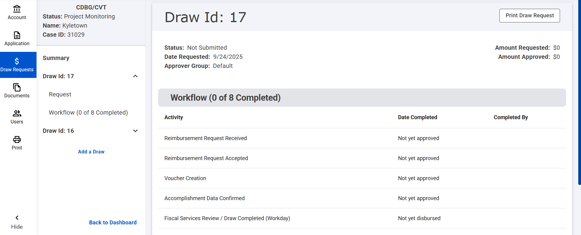
Neighborly
Add transparency – you will see the status of your draw based on the County workflow:

Slide 34
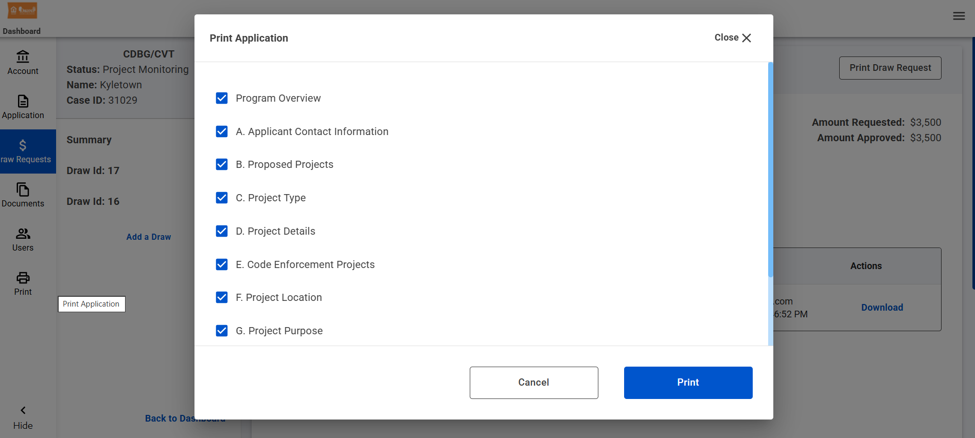
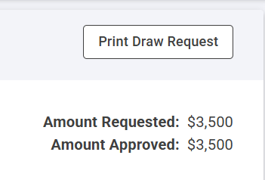
Neighborly
All of your application materials and draw requests can be printed to pdf and saved for your records:

Slide 35
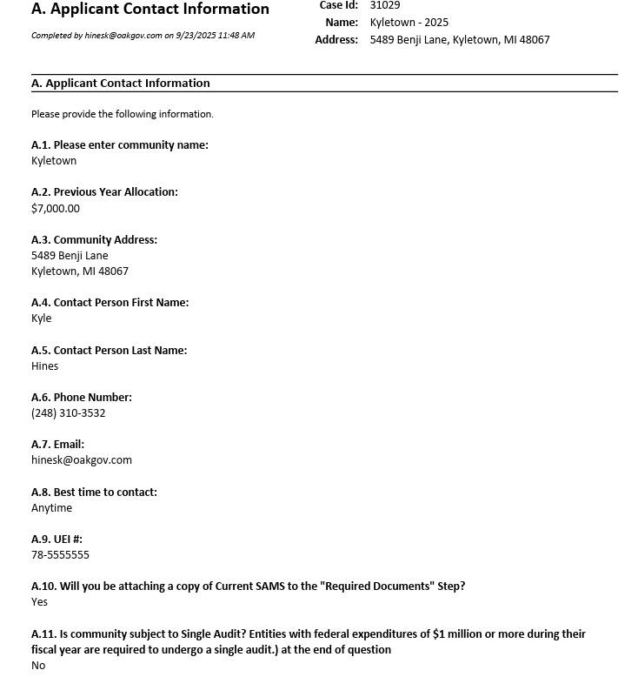
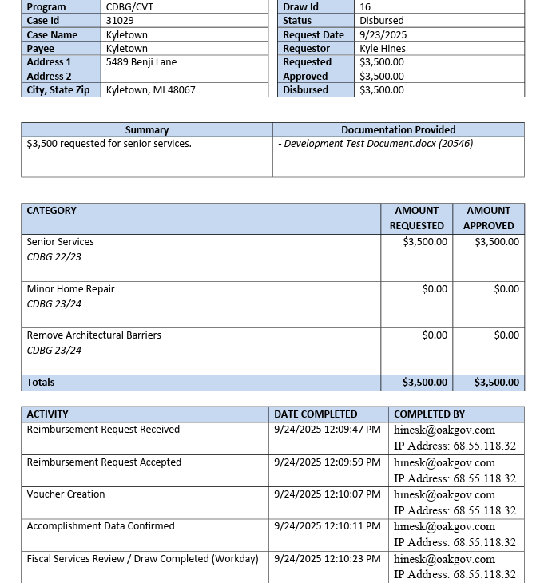
Neighborly

Slide 36
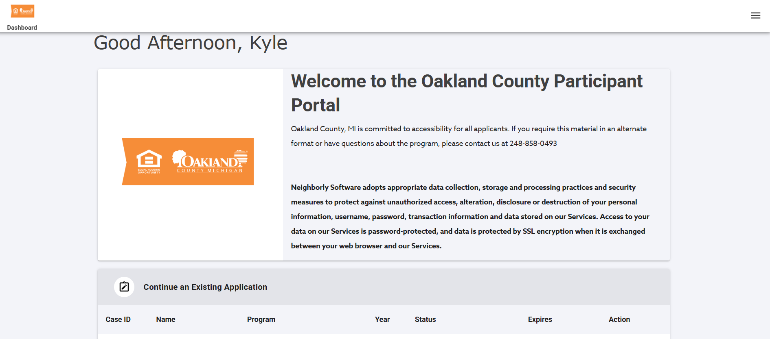
Neighborly
The Neighborly application portal is still under final revision with the Neighborly implantation team
You will be notified when it’s open for applications
We will provide live training at a future CDBG office hours
A step-by-step guidebook will also be provided

Slide 37
Submission Instructions
You MUST complete the application electronically via Neighborly.
Attach Required and Applicable documentation
Copy of current SAMS
Applicable Environmental Review Requirement forms and documentation.
Notice of Public Hearing (Option 1 or 2)
Public Hearing Minutes (Option 1 or 2)
Conflict of Interest Form
Affidavit of Compliance
Submit ALL Application documentation by December 5, 2025 via Neighborly.

Slide 38
Public Hearing
Participating communities are required to advertise and conduct a Public Hearing
Option #1 allows for public hearing notice to appear in a newspaper of general local circulation at least 10 days before the hearing
Option #2 allows for public hearing notice to appear in a posting at the community and on the community website at least 10 days before the hearing unless procedure violates local public hearing notice requirements
    Acceptable only if:
      The community has approved by ordinance/resolution the use of web posting for CDBG Public Hearings and has provided a copy of the ordinance/resolution to OCNHD at the time of application; and
      This procedure does not violate local public hearing notice requirements

Slide 39
Public Hearing
“The Hearing will be held on XXX, XXXX, 2025 at 7:00 p.m.at the City/Village/Township Offices… for the purpose of hearing public comments on the CDBG Program Year 2026 application to fund eligible projects."
We will look at the resolution for an exact approval of the project and projected amount of funding the city/village/township will request.

Slide 40
Citizen Participation
Participating communities are required to conduct a Public Hearing for the CDBG application. HUD requires a public hearing in order to receive comments from the public regarding the CDBG application.
Public comments must occur after hearing is open and before it is closed.
Staff/ official comments must occur before or after the hearing. Additional information can be added to these required clauses to meet specific local needs and to encourage participation
Option 1: Meeting Minutes
  The meeting minutes must clearly show an open and close of the public hearing, the planned use of CDBG funds and approval of the application.
Option 2: Governing Body Resolution
  The governing body resolution must clearly show an opening and closing of the public hearing, the planned use of CDBG funds, and the approval of the application. Additional information can be added to these required clauses to meet specific local needs and to encourage participation.

Slide 41
PY 2026 CDBG Application
  Application Deadline
  5:00 p.m.
  December 5, 2025
No late application will be accepted
No exceptions

Slide 42
Scoring Rubric
PY2026 Scoring Evaluation ​
  Capacity - 10 points ​
  Community Need - 10 points ​
  Project Description - 35 points​
  National Objective - 15 points ​
  Active History - 5 points ​
  Leveraged Funds – 10 points ​
  Citizen Participation – 5 points ​
  Prior’s Year’s Fund - 5 points ​
  Creativity - 5 points ​
  Total Points Possible: 100​

Slide 43
Scoring Rubric
Capacity - 10 points
Applicant has experience with a similar project
No contract amendments related to time of performance were needed to complete a project during the applicant's fast two program years
Applicant did not have funds recaptured during the prior two years
During the last two program years the applicant has responded to inquiries forwarded through the County within the prescribed time frames
Applicant has complied with similar cross cutting requirements with previous funded CDBG projects with little technical assistance required
Community Need - 10 points
How impactful is this project to the needs of the community?
Project does not meet a priority included in the Annual Action Plan / Consolidated Plan?
Project Description - 35 points
Scope of work is complete, detailed, and concise
Complete description of service area and the number of residents that will benefit from the project
Detailed reasonable cost estimate
Maps and photos of the project area
Timeline showing that the project can be completed within 18 months
National Objective - 15 points
Low/Mod Housing LMH
Low-Moderate Income Clientele (LMC)
Low - Moderate Income Area Wide Benefit
Slums & Blight (Area or Spot Blight)
Presumed Benefit

Slide 44
Scoring Rubric
Active History - 5 points
Unspent Activity Funds less than 1 year
Unspent Activity Funds greater than 1 year
Leveraged Funds – 10 points
Funds Leveraged >50%
Funds Leveraged 35% - 50%
Funds Leveraged 20% - 34%
Funds Leveraged 10% - 19%
Funds Leveraged < 10%
Project relies solely on CDBG funds
Citizen Participation – 5 points
Points awarded for public engagement beyond the public hearing
Prior’s Year’s Fund - 5 points
Have not received facility award in the last 2 years
Received facility award in the last 2 years
Creativity - 5 points
The proposed project addresses the specified need through innovative and creative means (partnerships, new project type, etc.)

Slide 45
Application Assistance
  For assistance with the application process, please call Ashley Hinton in the Neighborhood & Housing Development Division
  (248) 858-5312
  Toll Free(888) 350-0900 x 85312
  Email at hintona@oakgov.com

Slide 46


Slide 47
Environmental Review Record
Katie Tierney, Senior Specialist – Environmental Officer

Slide 48
Environmental Review Responsibilities
The Office of Environment and Energy (OEE) manages the environmental review process for HUD
During environmental review, a project is evaluated for potential environmental impacts to determine whether it meets federal, state and local environmental standards

Slide 49
Environmental Review Responsibilities
The environmental review process is required for all HUD-assisted projects to ensure that the proposed project does not negatively impact the surrounding environment and that the property site itself will not have an adverse environmental or health effect on residents and the surrounding community.

Slide 50
Environmental Review NEPA
National Environmental Policy Act (NEPA)
Requires us to integrate environmental values into our decision-making processes by considering the environmental impact of our proposed actions and reasonable alternatives to those actions.

Slide 51
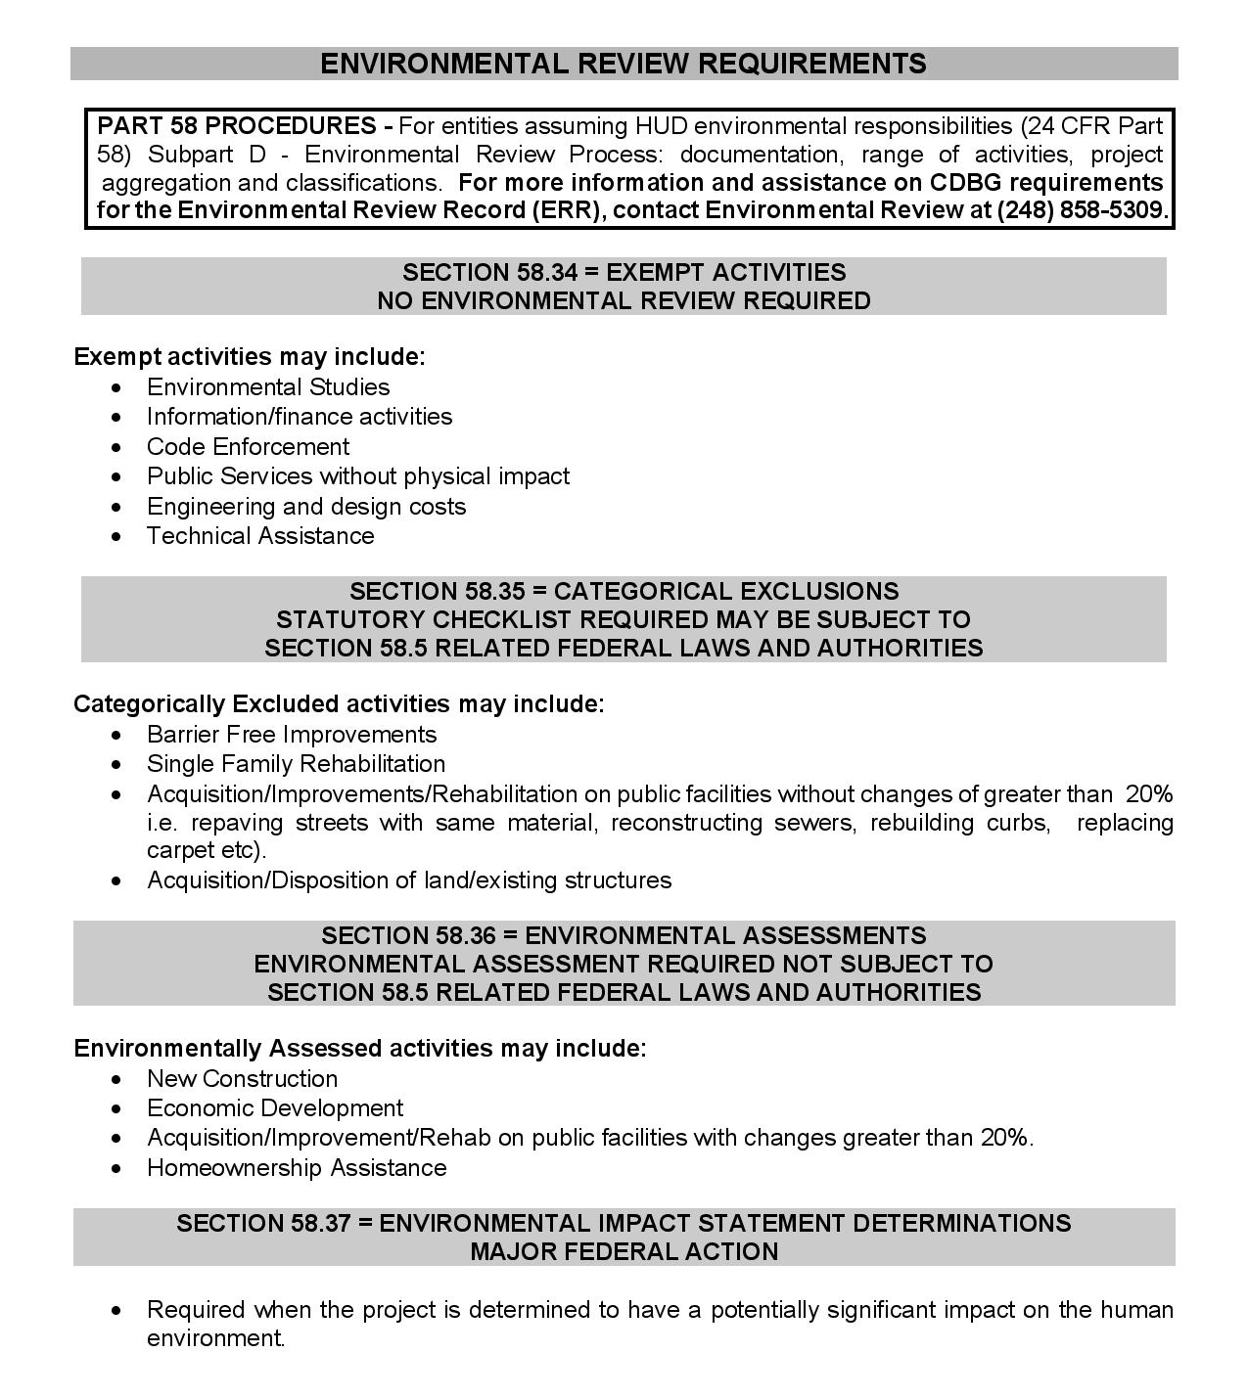
Environmental Review Outline

Slide 52
Environmental Review Requirements
Environmental Review
Required with the Annual Application
Required with all reprogramming requests
One Review Per Project
    If funded in multiple years (must submit each year)
    Do not use the words none, not applicable (N/A) etc.

Slide 53
Project Description=Defining the Project
Purpose of the proposed project
Location
Size of the parcel and buildings
Benefits of and impact to the community
Existing conditions
Scope of work to be completed
Number of homes or units (estimate if unknown)
It is estimated that this activity will take up to five years to complete.

Slide 54
Project Description Example
The rehabilitation of Trepanier Hall will include repairs to elevators, replacement of security doors and roof exit doors, the installations of an interior/exterior entry points security system, mechanical updates to the heat system, air recovery system, bathrooms and kitchen, the installation of new sprinkler heads, the replacement of old windows with newer, energy efficient windows, energy efficient LED lights installed throughout the building, covering old worn floors with new flooring, and the addition of wall partitions to better utilize space.
It is estimated that this activity will take up to five years to complete.

Slide 55
Project Description Example
To enhance neighborhoods by removing and replacing existing sidewalk that does not comply with current City safety standards. The sidewalks in noncompliant status create difficult and/or dangerous conditions for pedestrians.
  Concrete flags will be identified for removal and replaced with new concrete sidewalks to proper grade and eliminate trip hazards. The concrete removed shall be disposed of in a manner consistent with all federal, state and local laws and regulations.
  Due to the nature of the proposed sidewalk improvement processes of removing and replacing existing concrete sidewalks, there will be no adverse impact on the environment. It is estimated this project will take up to five years to complete.
  The City had in the specs but not in the ERR there were many locations for tree root removal in addition to sidewalk replacement which would have a need for more invasive foundation groundwork. SHPO and THPO would have needed to have been contacted.

Slide 56
Tree/Bush Removal – Ground Disturbance Endangered Species
We are trying to stay away from any habitat disturbance at this time.
If a tree needs to be taken down, you must contact our office beforehand, and we may need to come out and see it.
Pictures have to be taken for the file.
If the work is being done on an already manicured lawn, that is fine, we just needs pictures and document the file stating just that.
Depending on what we find, professional consultation may be needed.
Hazardous tree removal will trigger iPac, but it does get expedited.
  Be sure to let us know if it’s a hazardous tree and if there is going to be ground disturbance.
New iPac system being used with the Fish & Wildlife Service now with endangered species which may trigger a higher level of review.
Ground disturbing activities may trigger THPO consultation.

Slide 57
SHPO/Section 106
THPOs
New guidance on Minor/Mobile Home repair SHPO/Section 106
  Previous exemption form is now obsolete
If you apply for a public facilities activity, be prepared as soon as you receive approval to hire an architectural historian. SHPO does provide a list of approved people to hire.
Memo states any rehabilitation work done must be sent to SHPO for evaluation before the work can be done
  Allow 30 days for SHPO to respond
Any significant ground disturbance, THPOs will need to be contacted (this is done by the County)
  For PY2025, section 106 checklist must be included with all tier II’s; we do have to notify THPO’s this PY. (July 1, 2025 – June 30, 2026)
  Traditionally, 30 days must be allowed for THPO’s to respond
Guidance for Categorizing an Activity as Maintenance for Compliance with HUD Environmental Regulation, 24 CFR Parts 50 and 58; Issued February 8, 2016

Slide 58
SHPO/Section 106 cont…
If you apply for a public facility project, such as
  Sidewalks
  Remove Architectural Barriers
  Parks & Rec Facilities
  Street Improvements
  Senior Center – non-exempt activities, etc.
You must hire an architectural historian from the SHPO website to complete the section 106 portion of your part 58 ERR.
  https://www.miplace.org/historic-preservation/programs-and-services/cultural-resource-management-and-planning/

Slide 59
500-Year-Old Floodplains
FEMA flood zones are expanding to what is known as the 500-year floodplain.
Anything that is in the 0.2-Percent-Annual-Chance Floodplain will now require flood insurance and/or 5 or 8 step process.
We would like to stay away from these areas as always!
HUD’s final rule which was published, April 23, 2024, at HUD's Final Rule updates the FEMA floodplain maps and the 8-step process.
You can watch the webinar here: Webinar Series Part 1: Part 55 Overview and Compliance

Slide 60
ERR’s good for FIVE years
If you still have 2021 and older money out there, you may need to complete a new environmental review on the project. If a reprogramming has taken place, you are all set.
HUD has changed the guidelines, and we must include that “It is estimated that this activity will take up to five years to complete” on each ERR.
You can find this information on the monthly finance report.
You have to get your money spent in a timely manner!!
The ERR(s) are due to me by 10/25/25

Slide 61
ERR – Exempt: Listed in 24 CFR 58.34(a)
Projects that do not effect environment
(must submit form & maps for each project)
Code Enforcement
Technical Assistance
Public Services (no physical impact)
Environmental & other planning studies
Strategic Plans
Engineering or Design Costs
Purchase of tools & insurance

Slide 62
Statutory Checklist
Airport – Must include map(s)
  The City of Berkley is not located within 15,000 feet of a military airport or 3,000 feet of a commercial airport. The nearest airport is Coleman Young International airport, and it is approximately 11 miles away. The project does not involve the sale or acquisition of developed property.
Coastal Barriers – Must include map
  This project is not located in a CBRS Unit. Therefore, this project has no potential to impact a CBRS Unit and is in compliance with the Coastal Barrier Resources Act. There are no Coastal Barriers in Oakland County.
Flood Insurance –
  The project does not involve mortgage insurance, refinance, acquisition, repairs, rehabilitation, or construction of a structure, mobile home, or insurable personal property and does not require flood insurance. Flood plains will not affect this project.

Slide 63
ERR - Categorically Excluded Subject To: 24 CFR 58.35(a)
Minimal Effect on Environment
Acquisition
Remove Architectural Barriers
Demolition
Sidewalks
Rehabilitation w/out changes of >20%
Surface with same material w/out changes of >20%
Statutory Checklist Required
Maps and Documentation
Notes:
Categorically excluded activities minimally affect the environment.
Replacing like with like
A statutory checklist, floodplain management, and historic clearance is required.

Slide 64
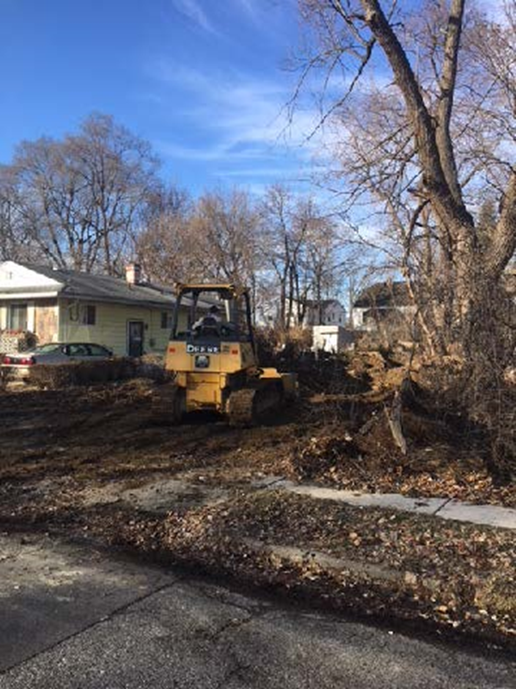

Slide 65
ERR - Environmentally Assessed
  Non-Exempt or Categorically Excluded Projects must complete a Full EA – Majority of projects do not fall in this category
May have an effect on the environment
Residential buildings when density is increased over 4 units or when
land use changed
Water
Sewer
Major Rehabilitation
Most new construction and, reconstruction
Whenever no exclusion applies
Statutory Checklist Required
Maps and Documentation

Slide 66
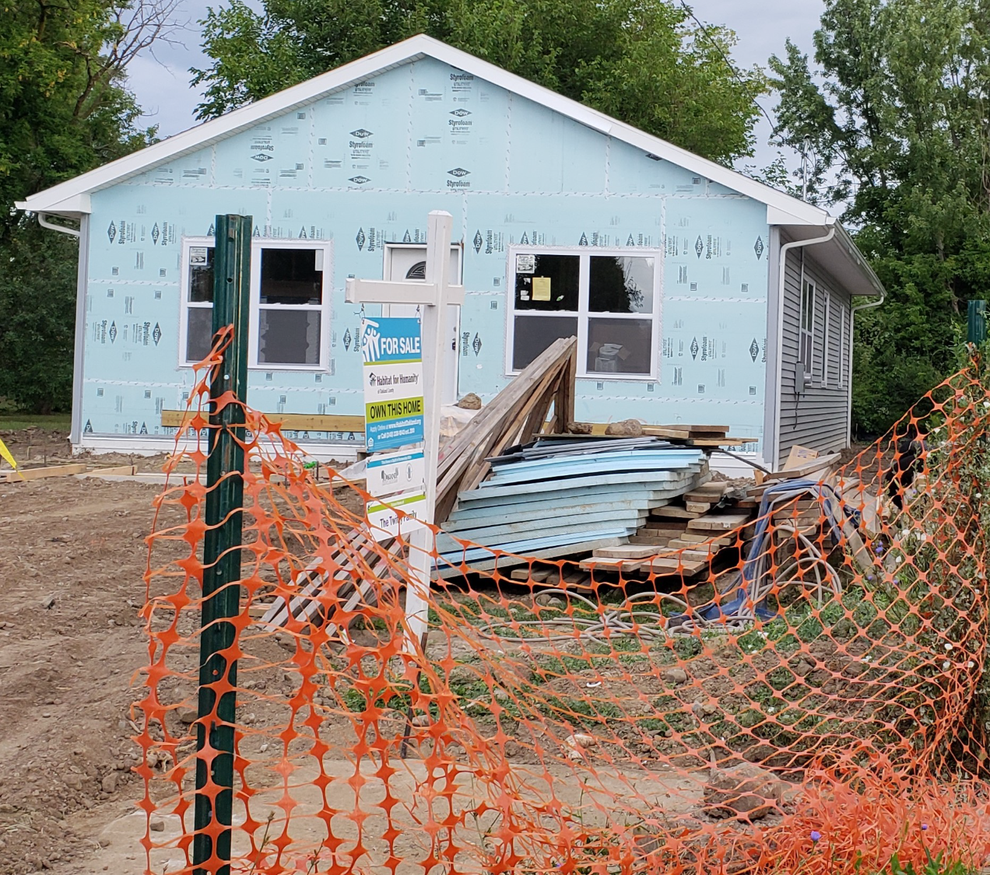

Slide 67
ERR - Source Documentation
Use Federal, State, local oversight agency or recognized authoritative sources and verifiable documentation
  Verifiable: City/county land use plans, FEMA maps, zoning maps, USGS top maps, historic registers, aerial photos, EPA, Noise Analysis, grading plans, asbestos surveys, wetland delineations, etc.
  Relevant: Field observations, photos, interviews, printed materials, letters, emails, phone logs, reports, studies, etc.
  Do not use the words none, not applicable (N/A) etc.

Slide 68
Credible Websites
EPA NEPAssist – Look for toxic and hazardous locations https://nepassisttool.epa.gov/nepassist/nepamap.aspx
HUD Exchange – Related Federal Laws & Authorities
https://www.hudexchange.info/programs/environmental-review/federal-related-laws-and-authorities/
Endangered Species – Habitat Disturbance https://ipac.ecosphere.fws.gov/
SHPO/Section 106
https://www.miplace.org/historic-preservation/programs-and-services/cultural-resource-management-and-planning/
WISER Training - https://www.hudexchange.info/trainings/wiser/
Must have a HUD login to complete the WISER training

Slide 69
Environmental Review Record
Bidding and construction of a project
May not begin nor funds obligated or expended until the ERR process has been completed and approved - OCNHD will not reimburse
ERR will vary in length and content
Depending upon the level of review required for the activity

Slide 70
Environmental Review Record
ERR is written evidence “administrative record” of review-decision making-action
One per project
Reviewable to public/HUD/OCNHD
Contains evaluations, proper HUD forms, findings, decisions, documentation, maps, resources, notices, permits and approvals
Your proof of procedural compliance with Federal and State environmental laws and your defense against any environmental challenges
File with application and/or reprogramming

Slide 71
Environmental Review Record
Person(s) completing ERR does not need to be a technical expert - should be credible in case it becomes necessary to defend the ERR and level of clearance
Person filling it out signs as the preparer
OCNHD Environmental Officer/ Approver is Katie Tierney on Exempt, CENST’s and CEST’s
OCNHD Certifying Officer is Executive David Coulter on all Environmental Assessment’s/EA’s

Slide 72
Environmental Review Record
  For assistance with the Environmental Review process, please call Katie Tierney, Sr. Specialist - Environmental Officer in the Neighborhood & Housing Development Division
  tierneyk@oakgov.com
  (248) 858-5309

Slide 74
Contract Compliance
  Spending Performance
  Environmental / SHPO / THPO
  SAM Registration / Debarment
  Equal Opportunity
  BABA
  Quarterly Subrecipient Reports
Peter Essenmacher, Supervisor Contract Compliance

Slide 75
Spending Performance
More detail on contractor invoices.
Don’t say “services rendered” or “per specifications” be more specific.
For example: (100 lawns mowed @ $25 = $2500 billed)
DBA – Count starts over every July 1 or when account is expended.
DBA – Minor home repair = head of household = 1
Financial reports are being mailed out on a regular basis. Might not be exactly what your reporting because of timing of reimbursement.
Quarterly Reports will go out every 3 months along with the Financial Reports.

Slide 76
Administrative Capacity
Only apply for the number of projects you have capacity to expend within 18 months.
For example: Only apply for projects your staff can currently handle.

Slide 77
Reimbursement
To be reimbursed for CDBG activities, the CVT must prepare and submit a request for reimbursement. Use the checklist to help ensure documents are complete and the reimbursement package contains all needed items for timely reimbursements.

Slide 78
Reimbursement Check List
Community Reimbursement Request letter is complete.
On official letterhead
Community abbreviation, date, and total funds requested at the top
  Body of letter includes the total amount of reimbursement requested (this number matches the number on top of the form)
  Table is complete and accurate with the following with each fund, account, and program year on a separate line:
Program Year for funds expended
Account name
Account number
Total amount expended for PY account
Total amount of funds remaining as a result of the request
  Checks payable portion is complete, accurate, and includes the address the check should be sent to
Signature on bottom of letter
Language at bottom of form verifying truth of document

Slide 79
Reimbursement Check List
A complete reimbursement package shall include the following:
Community reimbursement request letter (see above)
Activities must have occurred after the release of funds date for the program year expending
Invoice(s) from vendor or contractor (must be dated before the check)
  Contract amounts over $10,000 must include a completed bid tab form, listing vendor as lowest bidder.
  Detailed invoice should match amount paid and contractor listed on check and bid tab
Copy of the check(s) copy paid to vendor (must be dated after the invoice from vendor)
Additional supporting information:
  Public service activities:
      Direct Benefit Activity (DBA) form (two pages) providing demographic data on the client(s) served

Slide 80
DBA
Direct Benefit Activity Report

Slide 81
Reimbursement Checklist
Public Service Contract between the community and the agency/vendor/contractor that is signed and covers the date(s) the service was rendered.
Contract Extension when needed.
Extension must be singed.
Extension dates must begin immediately after the contract expired and have a defined end date.
Davis Bacon projects need all documents submitted according to the pre-construction checklist (see attached also found on our website at https://www.oakgov.com/community/neighborhood- housing-development/grants-funding/community- development-block-grants-cdbg-contractors.

Slide 82
SAM Registration
Check SAM
Pre-Federal Award Requirements
Must have correct unique entity ID to receive federal award
All municipalities must register in SAM
SAM registration due with CDBG application

Slide 83
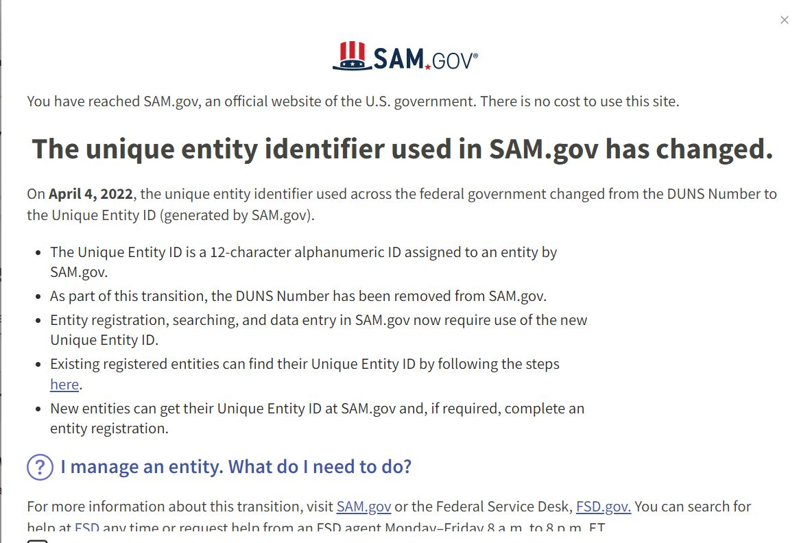

Slide 84
SAM Registration
Submit current SAM registrations with CDBG application
When HUD grant agreements are received Contract Compliance will check debarment status
If a municipality has an expired SAM registration, Contract Compliance will request an update
Your SAM’s registration must be current before CDBG award
Oakland County Fiscal Services may contact you time to time for their own reporting

Slide 85
SAM Contractor Debarment Check
Subpart C - Debarment Verification
All contractors must be checked for debarment PRIOR to award of contract using Federal Funds
SAM = System for Award Management
  https://www.sam.gov/content/home

Slide 86
SAM Debarment https://sam.gov/content/home
Start @ Home Page
Select – “Search”
Select “All Domains” - “Entity Information” – “Exclusions”
Input “Contractor name”
Hit “Enter”
You should see “No matches found” - Print this page
Note: If a contractor with a similar name comes up – print that page to reference this isn’t your contractor.
If you have an Account - Go to “Entity Information” sign in
Search “exclusions”
Note: there is a video tutorial

Slide 87

Equal Opportunity
ALL ADVERTISEMENTS - Equal Opportunity Programs/ Activities
HOUSING PROGRAMS -
ADVERTISEMENT FOR BIDS - This municipality is an equal opportunity employer, businesses owned by women or minorities are strongly encouraged to bid. advantageoakland/resources/Documents/chi_
ADVERTISEMENT_SAMPLE.pdf

Slide 88
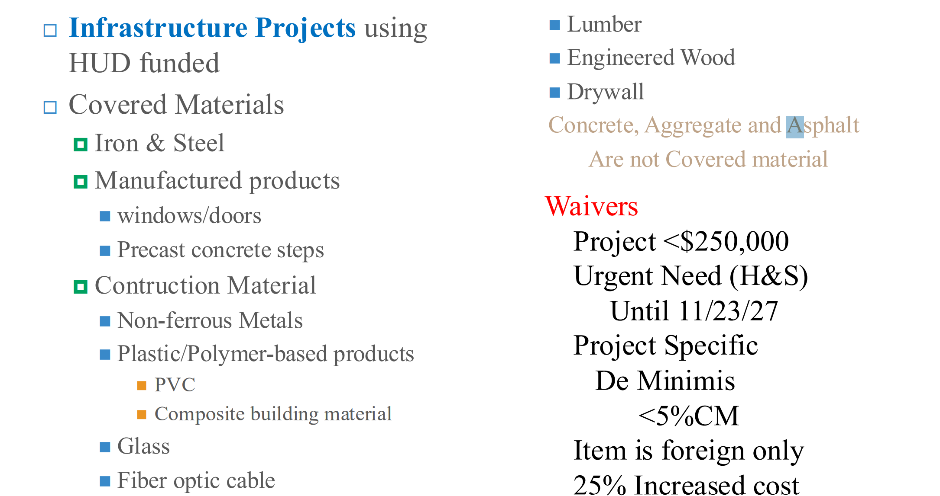
BABA

Slide 89
BABA Checklist
Oakland County Neighborhood & Housing Development BABA Checklist for CDBG Infrastructure Projects
Any infrastructure project over $250,000 total funding will need to meet Baba requirements
Minor/Mobile Home Repair is exempt (not for public use)

Slide 90
Home Improvement Contractors
Oakland County is looking to add Contractors to the Preferred Contractor List.
If interested: Contractor Packet

Slide 91
Contract Compliance
  For assistance with CDBG Contract Compliance, please call Peter Essenmacher, Supervisor, CDBG Compliance Unit
  essenmacherp@oakgov.com
  248-858-0196

Slide 92
Q & A/NEXT STEPS
QUESTIONS?
IMPORTANT DATES TO REMEMBER
Virtual Technical Assistance – Neighborly
Thursday October 9th 1pm
MONTHLY OFFICE HOURS
October 21st & November 18th
APPLICATION DUE
Friday, December 5, 2025

Slide 93
STAFF CONTACT INFORMATION
Peter Essenmacher, Supervisor, CDBG Compliance Unit
essenmacherp@oakgov.com
248-858-0196
Ashley Hinton, Grant Compliance Coordinator
hintona@oakgov.com
248-858-5312
Katie Tierney, Sr. Specialist - Environmental Officer
tierneyk@oakgov.com
(248) 858-5309
cdbg@oakgov.com

